Slide 1
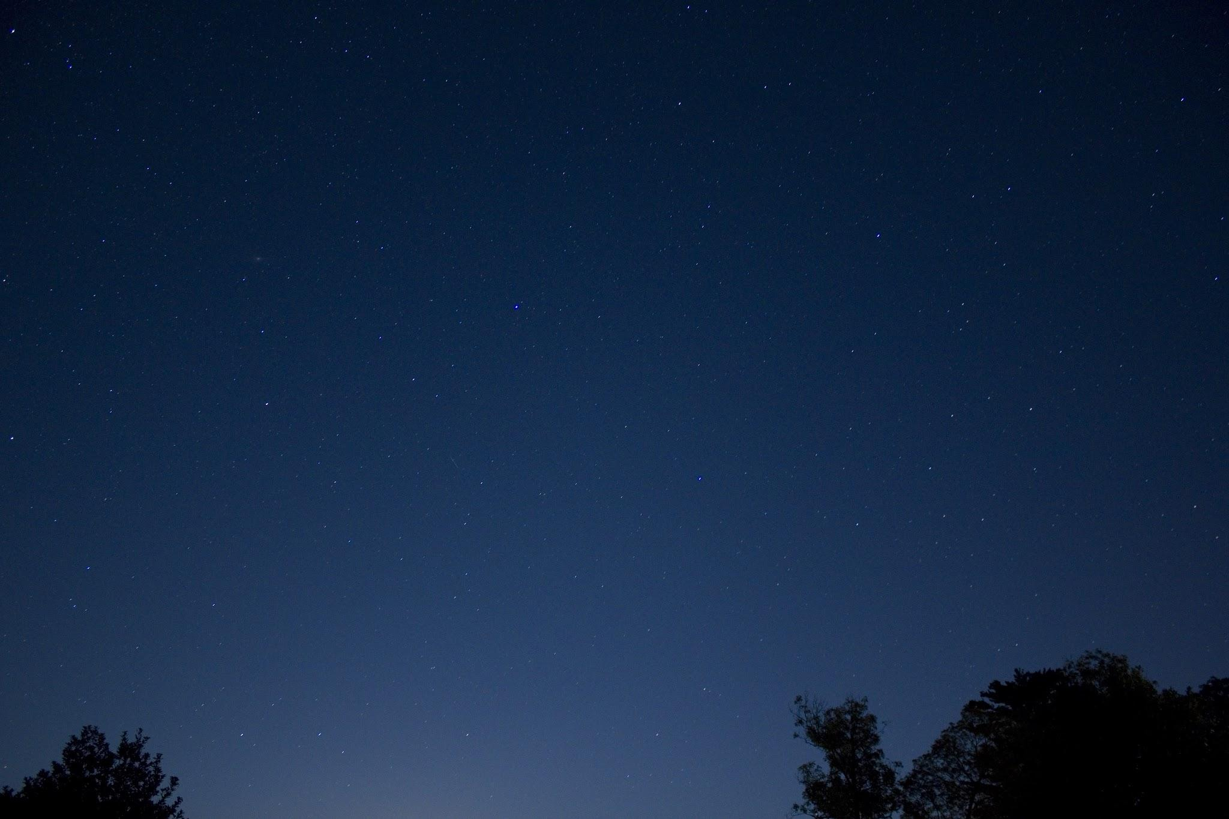
Trends in UFO Sightings (1910-2013)
An Analysis of Data from the USA, Canada, Australia, and Great Britain
4th Nov, 2024
Team Members:
Ken Priest
Rogelio Cardenas
Gayatri Rajagopalan

Slide 2
Introduction to UFO sightings Dataset:
Today, we will explore a dataset on UFO sightings across 4 countries - USA, Canada, Australia and Great Britain.
The dataset covers the years from 1910 to 2013.
This dataset includes various attributes such as:
the date and time of the sightings,
the countries,
states and cities where they occurred,
latitude and longitude of the cities,
the shapes of the objects observed, and
detailed descriptions from witnesses.

Slide 3

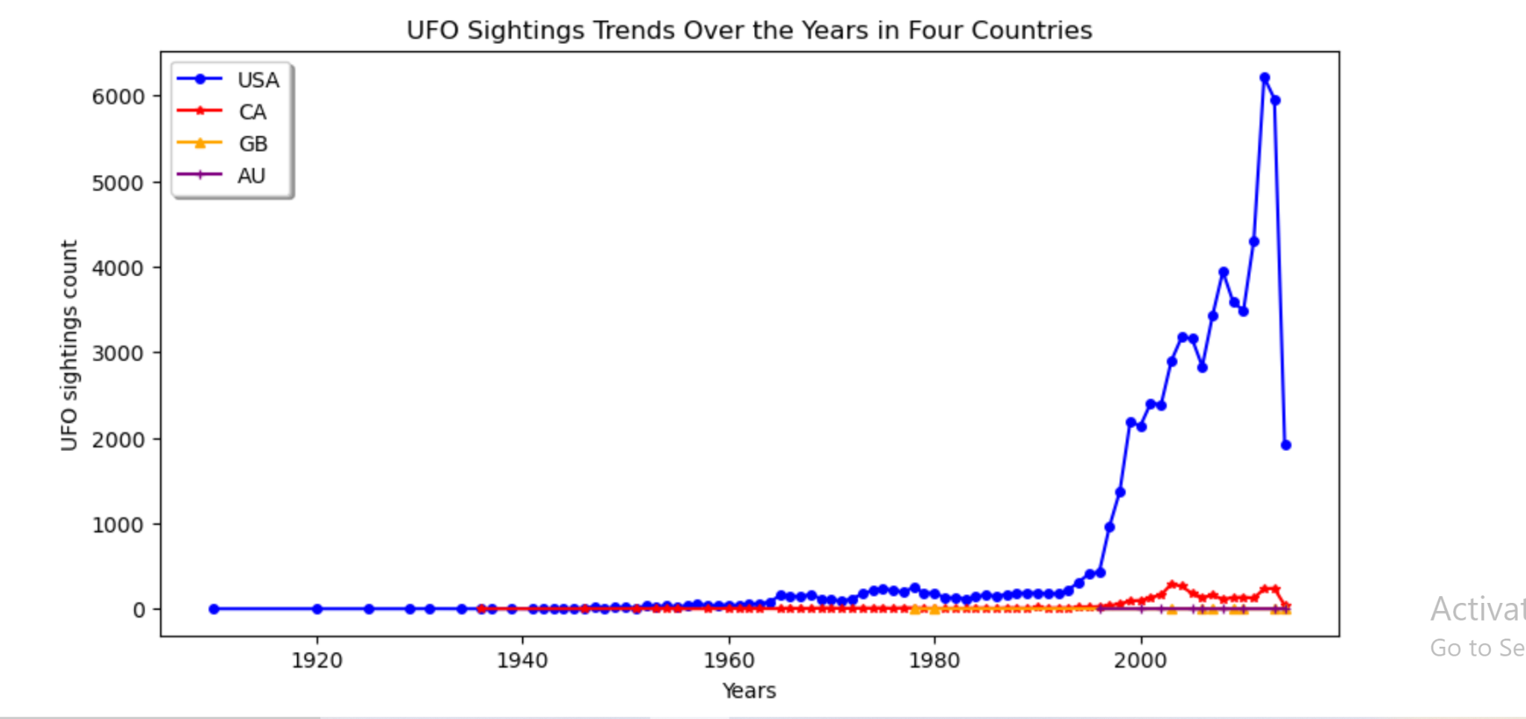

Slide 4
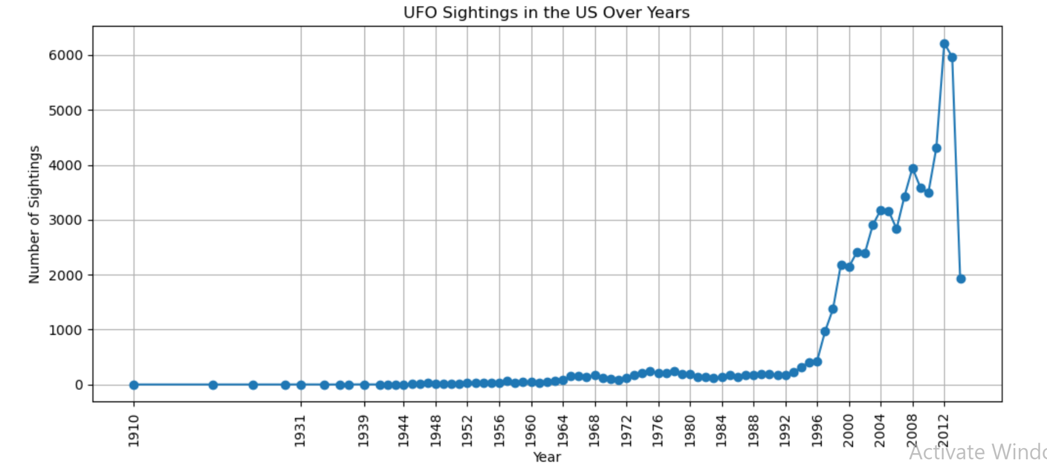
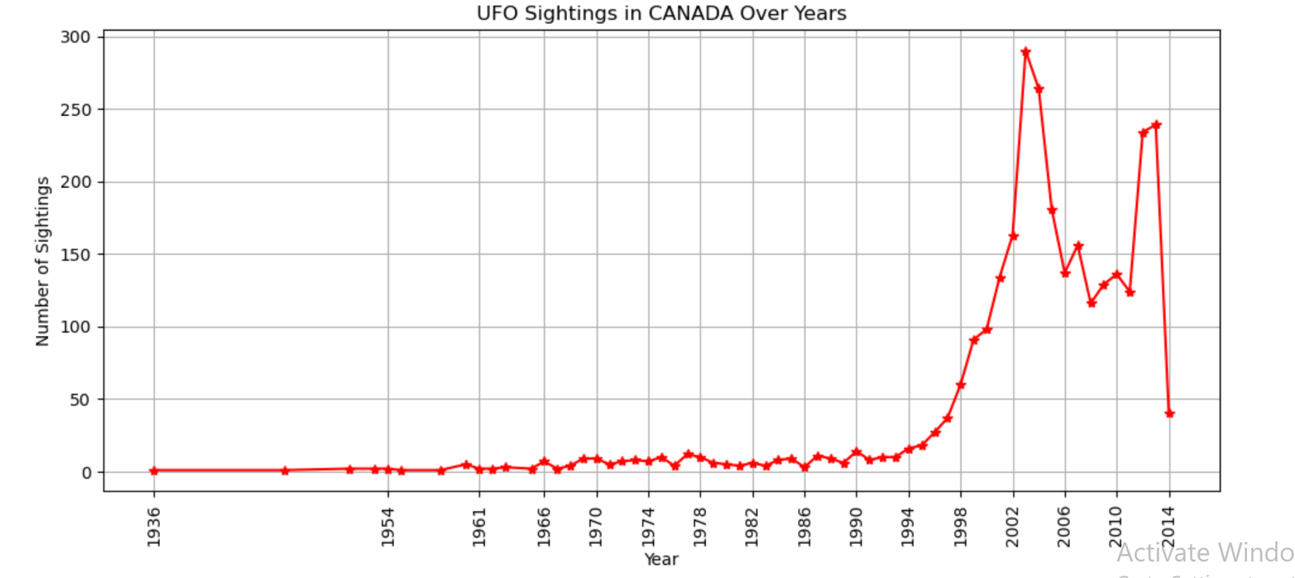
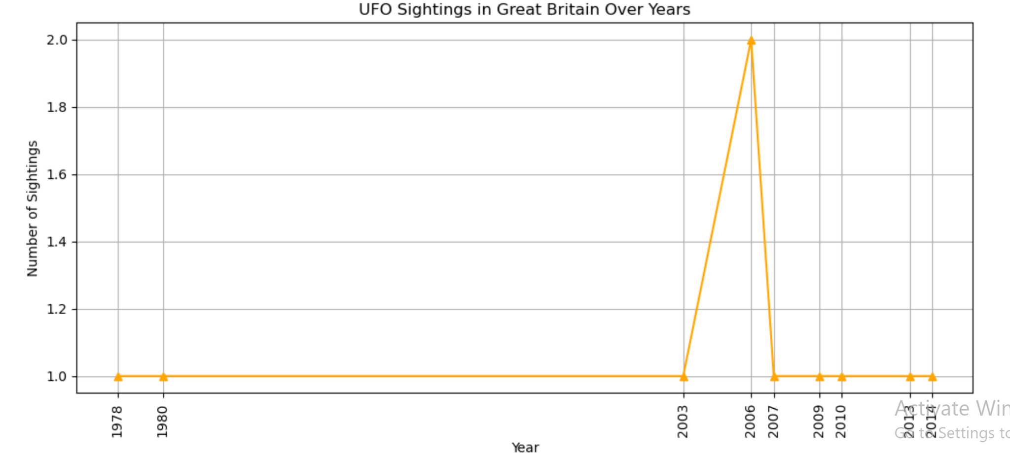
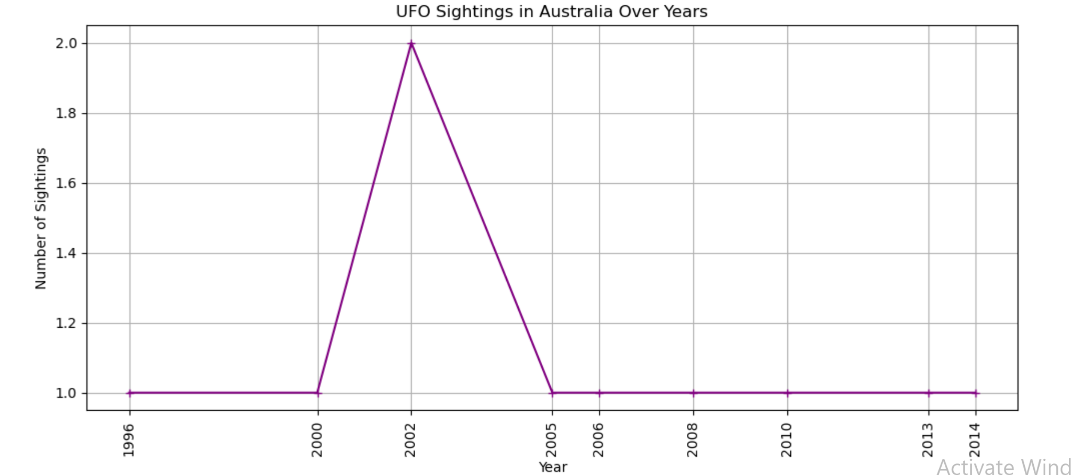

Slide 5
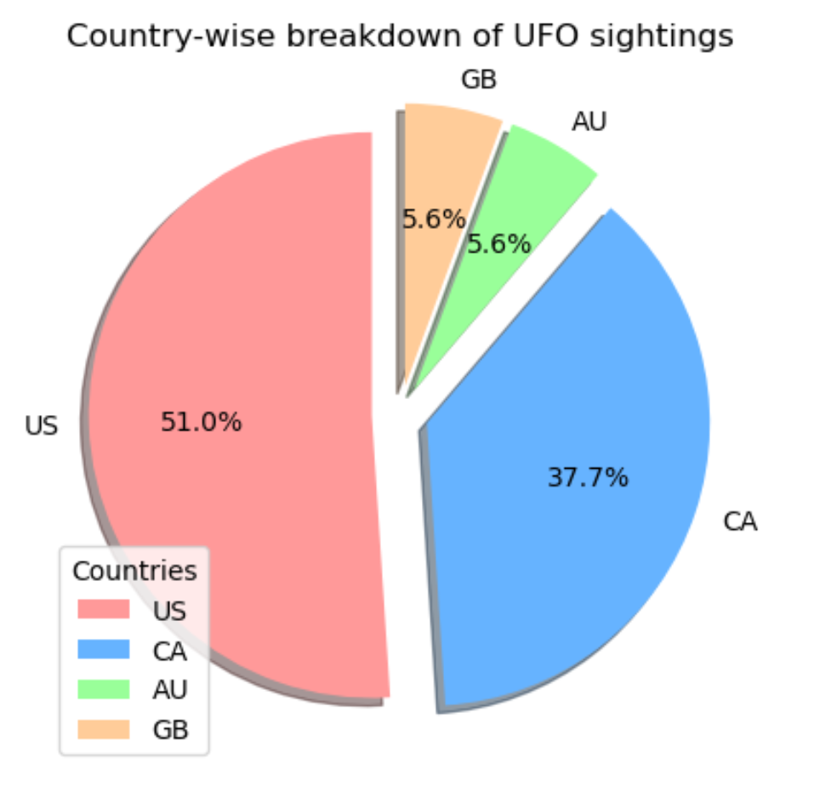

Slide 6
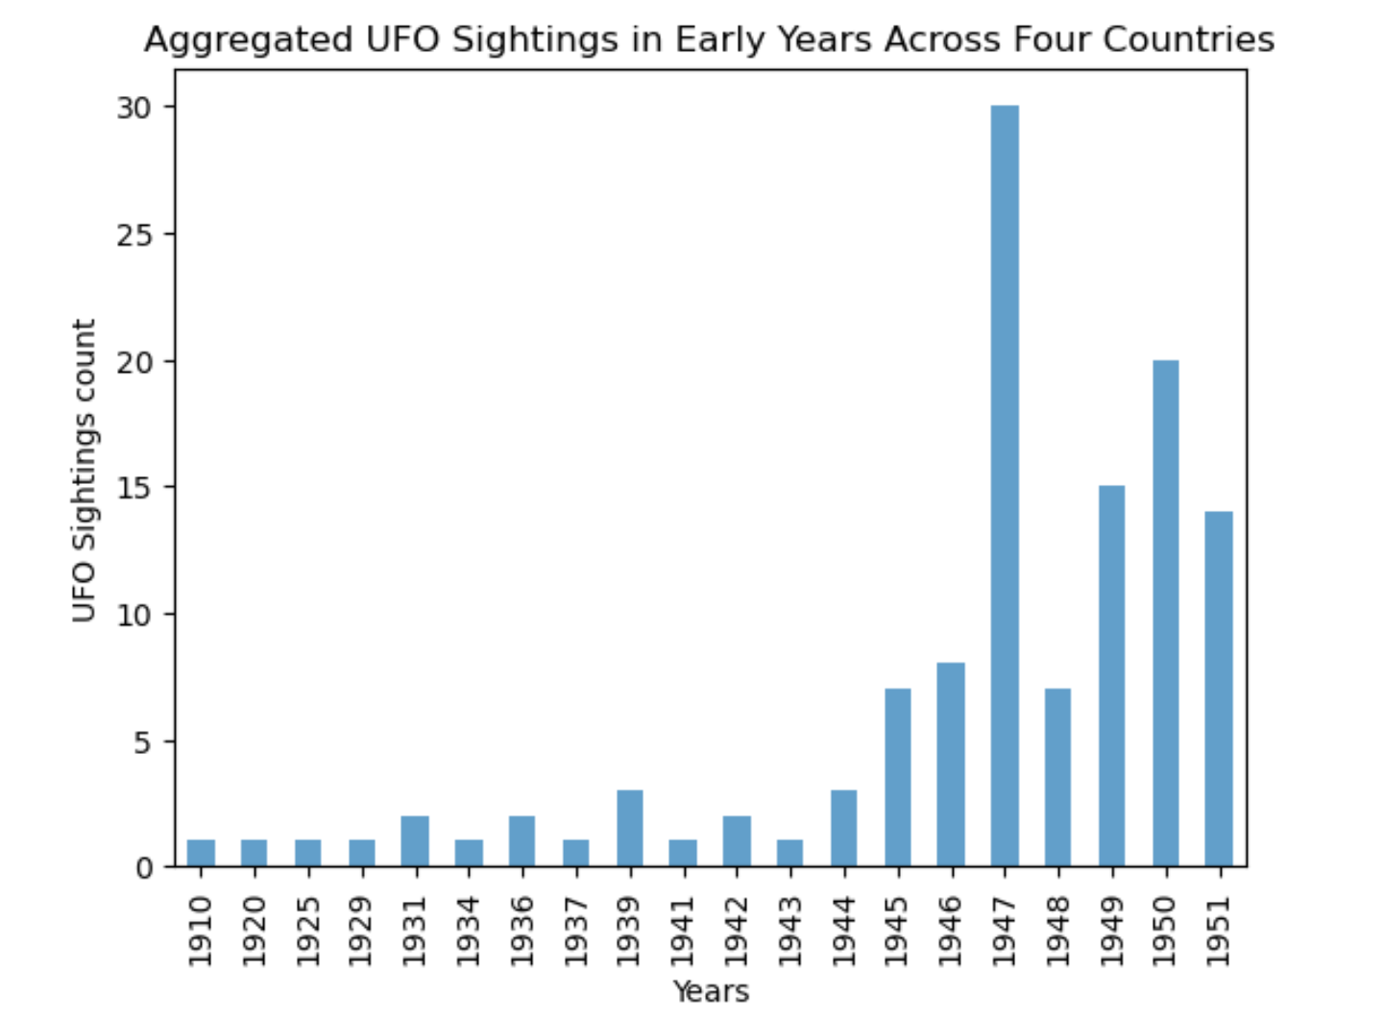
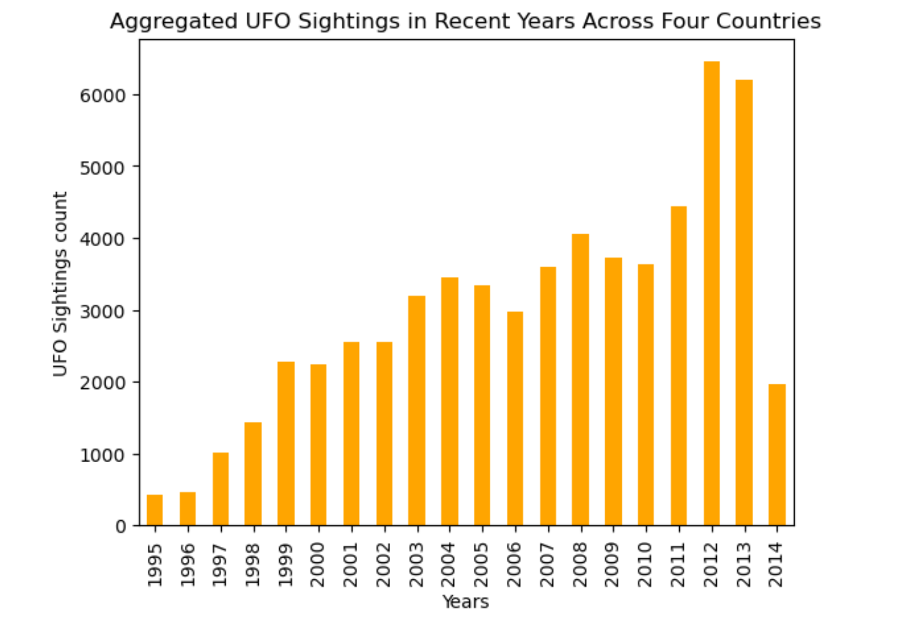

Slide 7
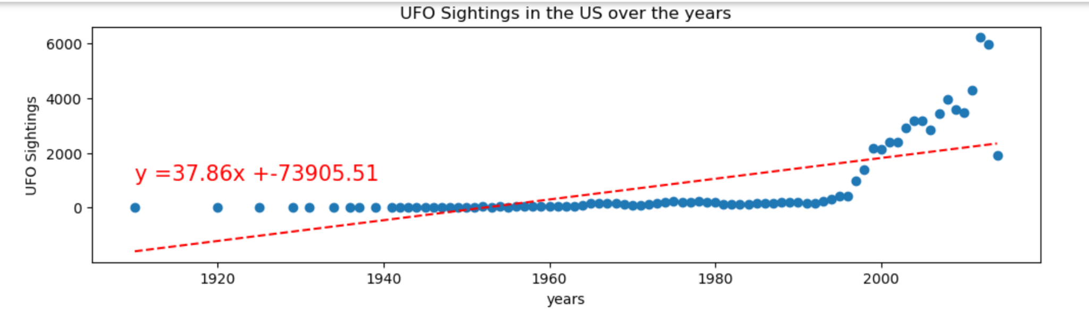
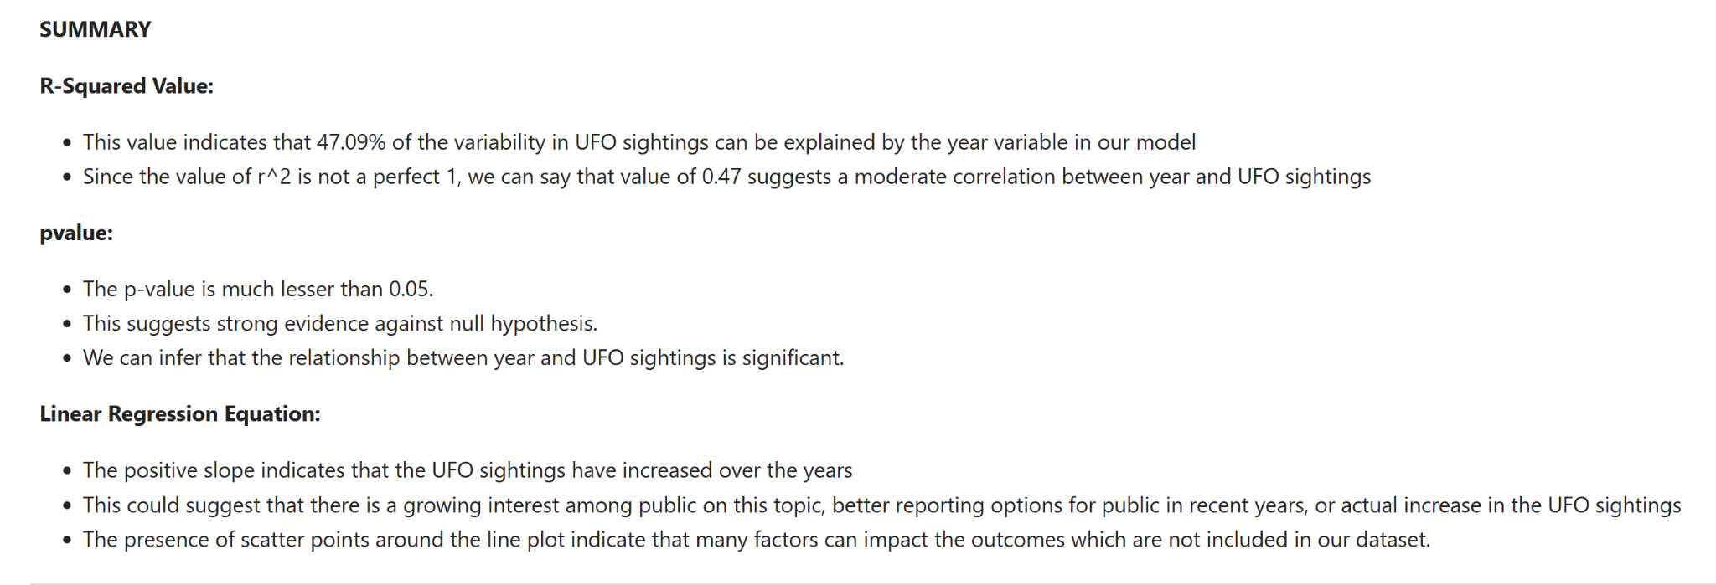

Slide 8
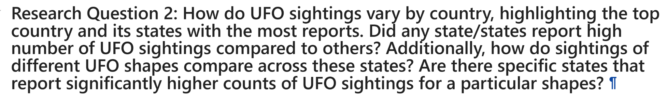
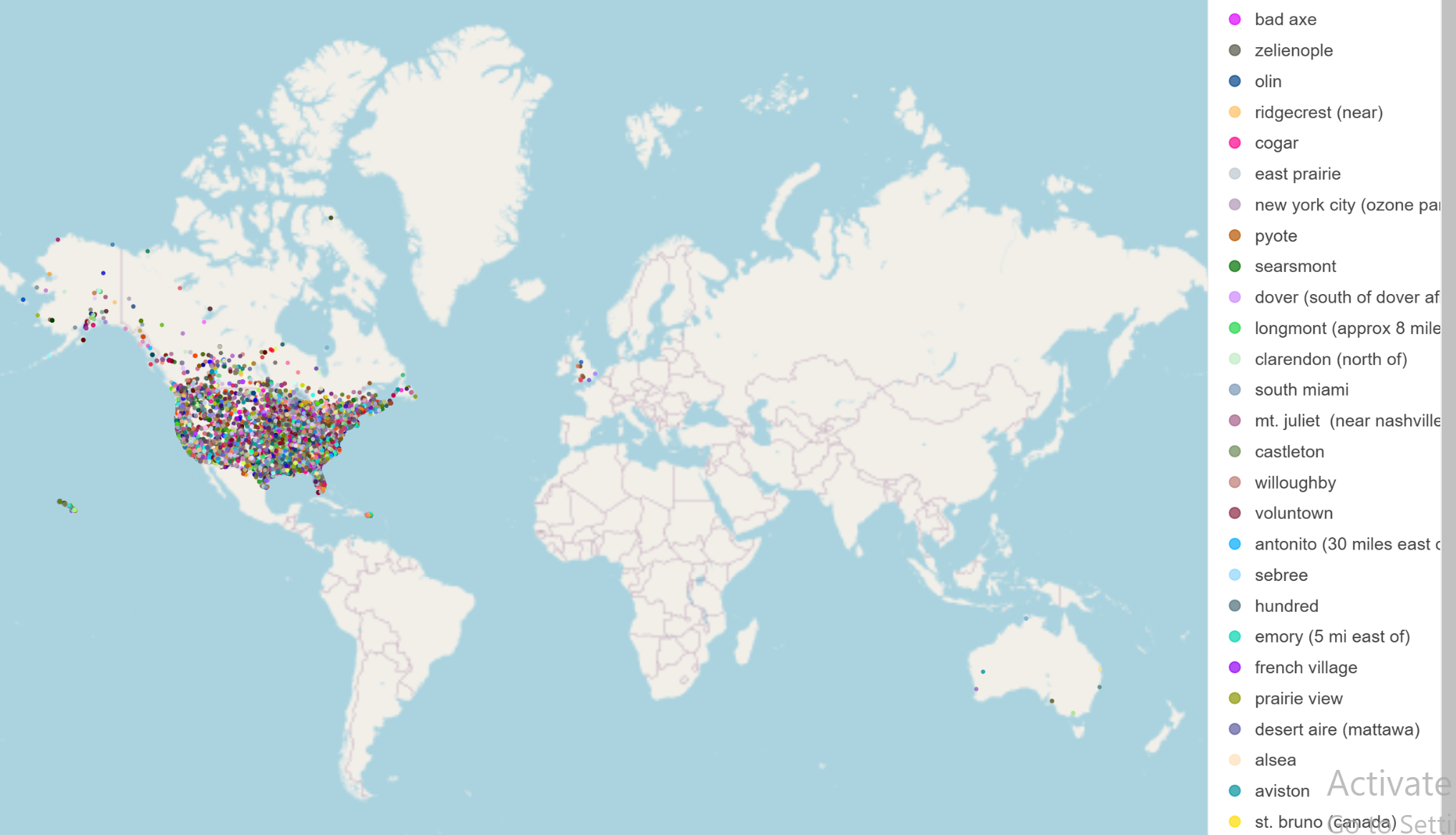

Slide 9
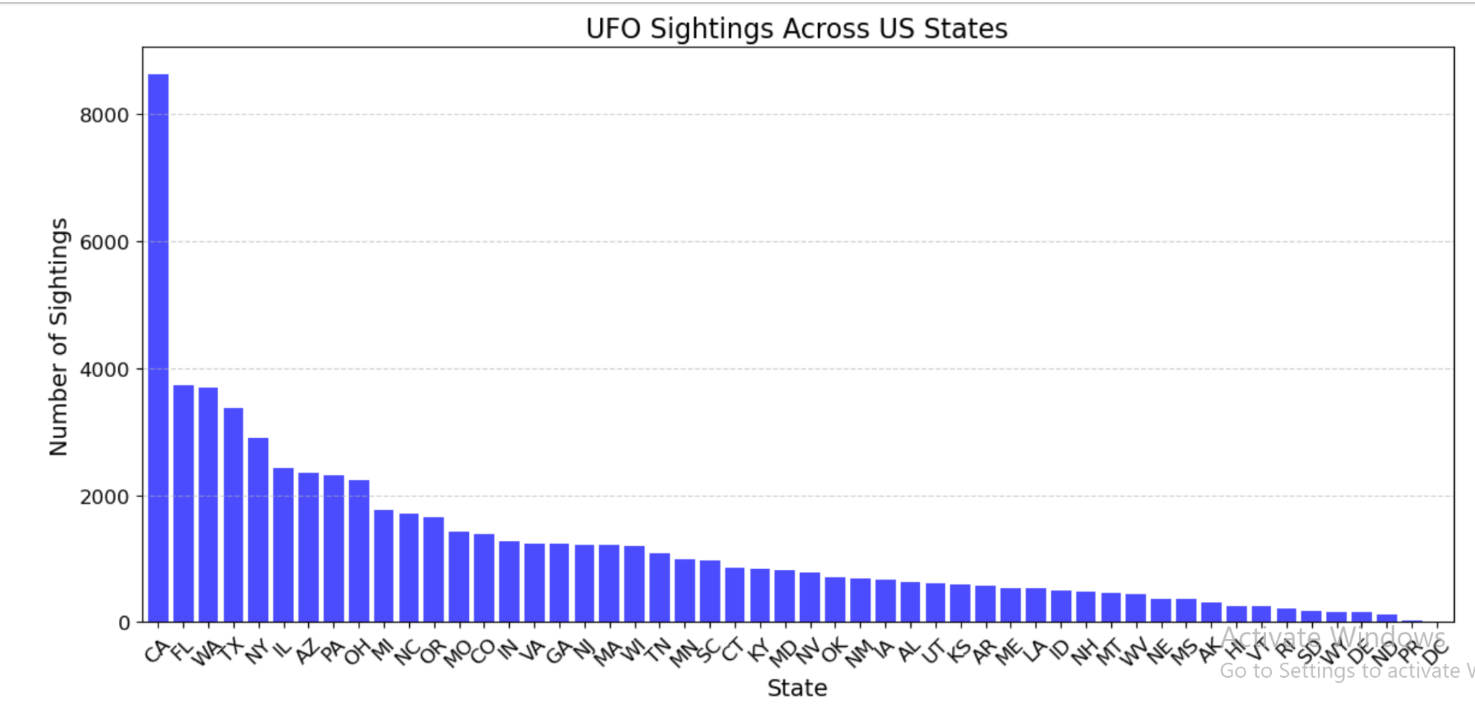

Slide 10
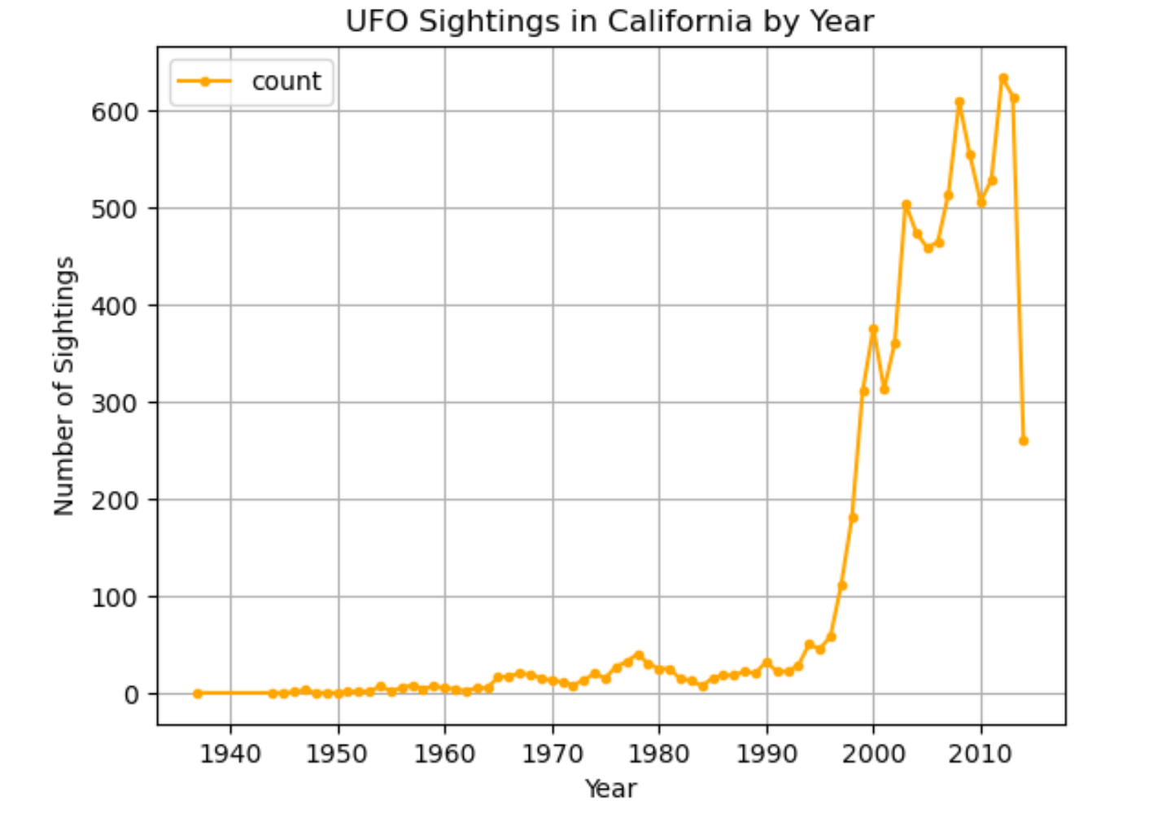

Slide 11
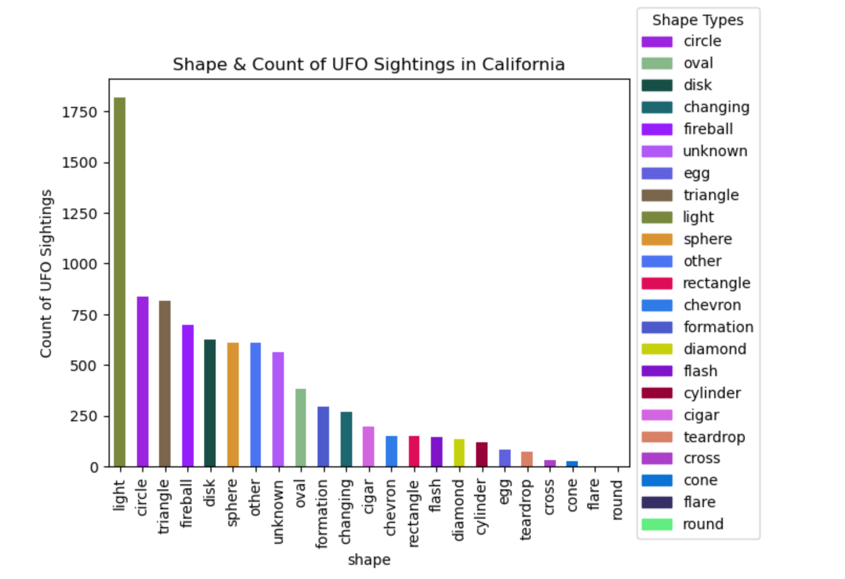

Slide 12
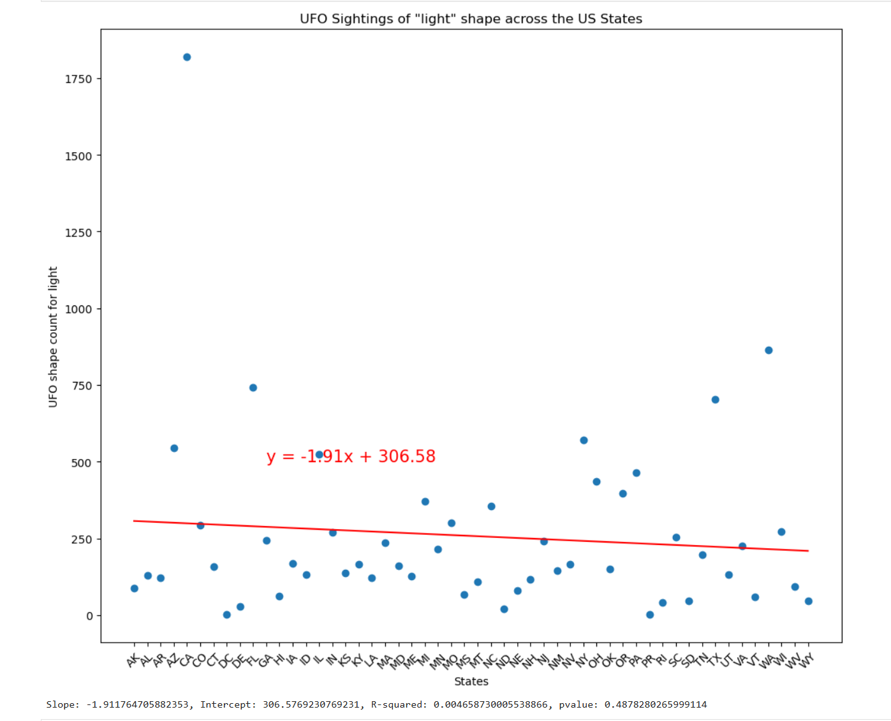

Slide 13
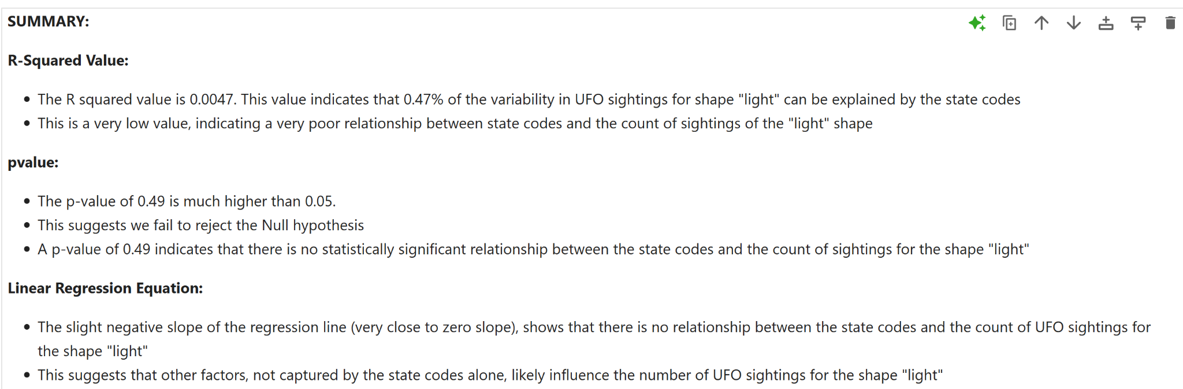

Slide 14
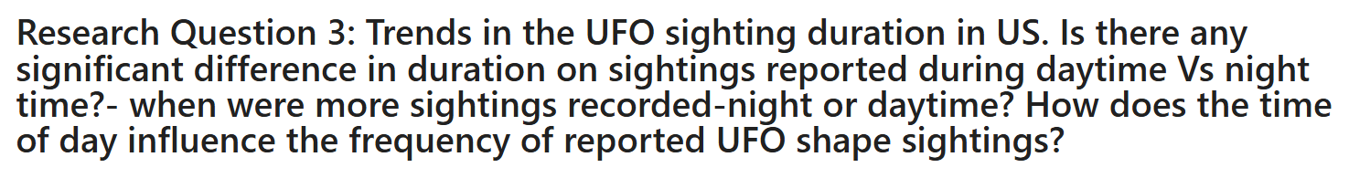
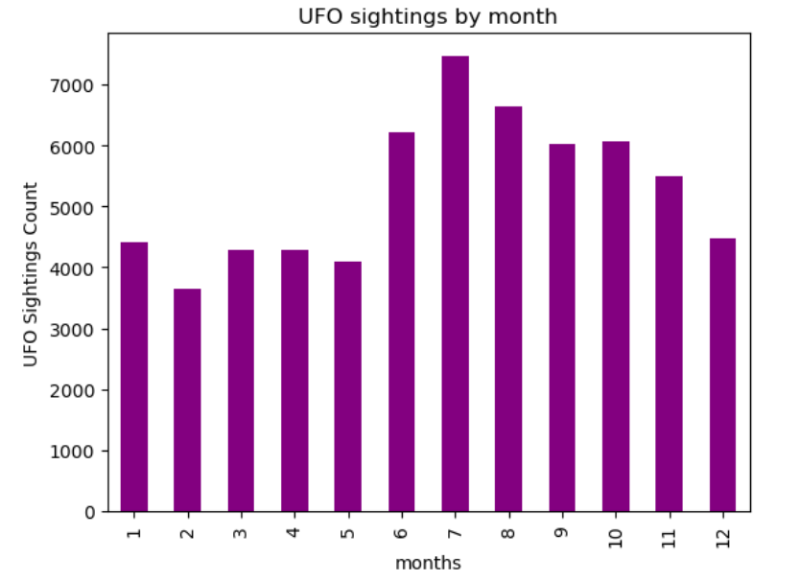
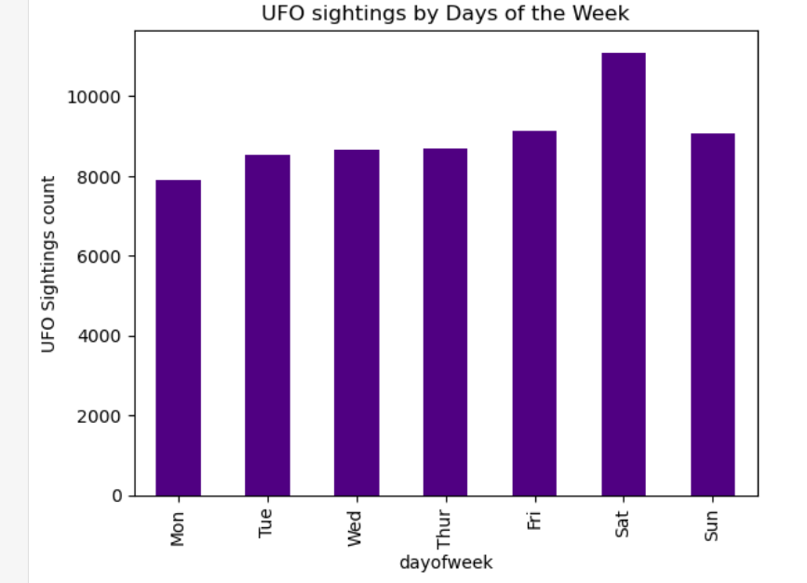
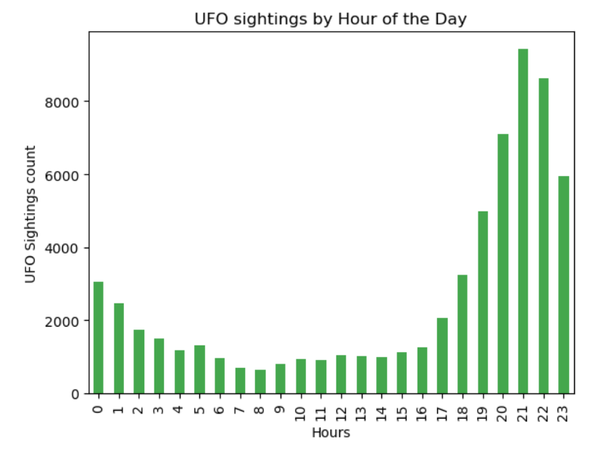
UFO sightings by month, Days of the week, and Hour of the day.

Slide 15
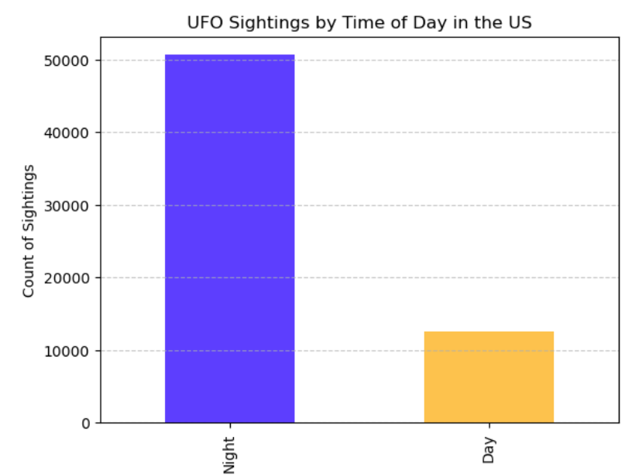

Slide 16
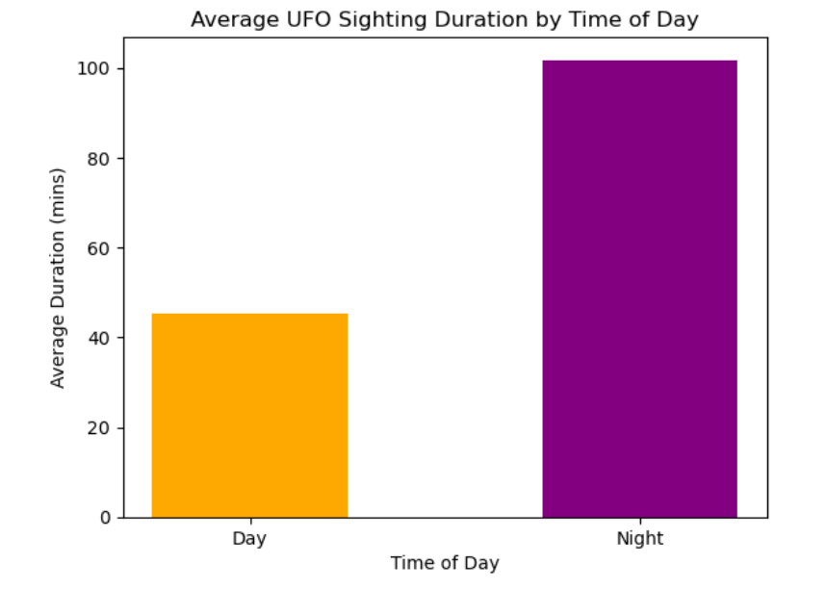

Slide 17
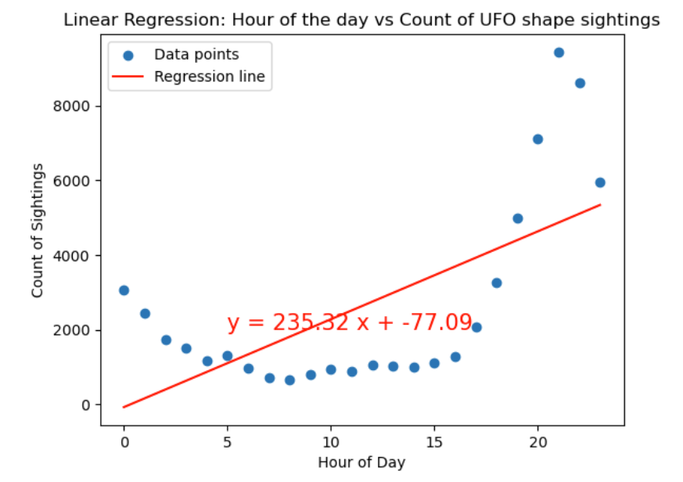

Slide 18
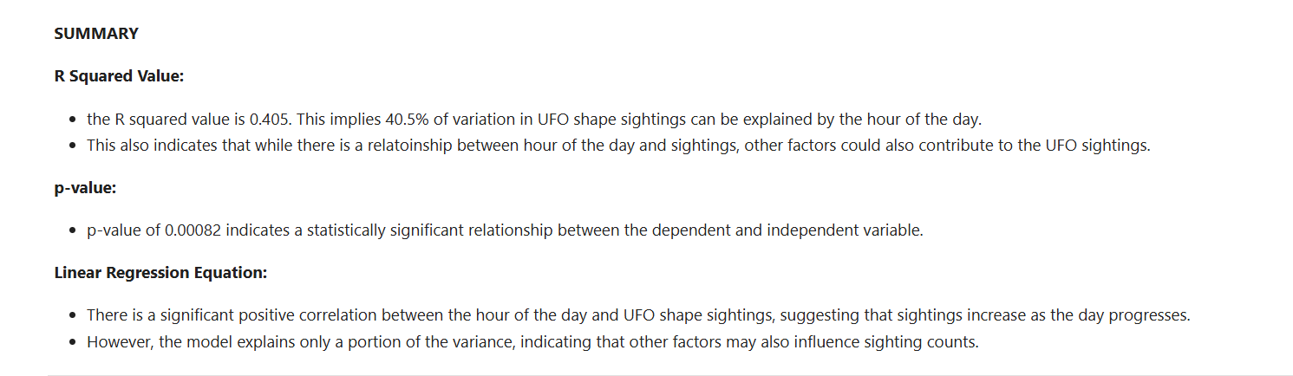

Slide 19

Thank You!

